Slide 1

Final Project 2
Prepared by:
Said Fawzy
www.linkedin.com/in/saidfawzy

Slide 2
Introduction
A company Needs to analyze its sales.
Data Came in .csv files
The data introduced was a historical data of sales in 1997 and 1998.
The report is supposed to be created in Jan 2000.
It is suppose to clean, Create data model and create interactive report for top management to support them in decision making for next year

Slide 3
Analysis should Answer the following Questions:
Which Region sells well , and which ones need more concentration in our next Marketing Cobain.
Which people are interested in our products and which ones are not and what to do to grasp their attentions.
Which seasons we sell will and which product do we sell more.
What is the recommendations for the future for getting more selling.

Slide 4


Slide 5
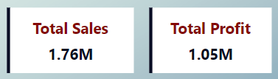
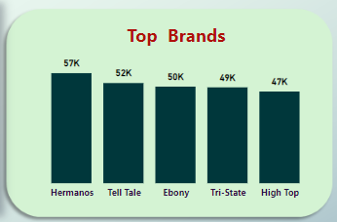
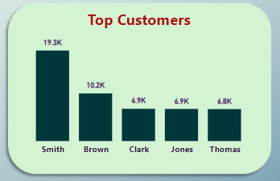
Findings (Sales Overview)
Total Sales were 1.76 M
Total Profit was 1.05 M
Top Sales Brand was Hermanos.
Mr. Smith was the Top Customer.

Slide 6
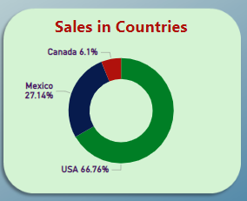
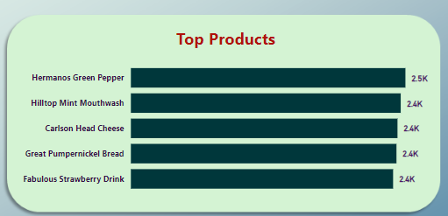
Findings (Sales Overview)
Top Country in Sales were “USA”.
Top Selling Product were “Hermanos Green Paper”.

Slide 7
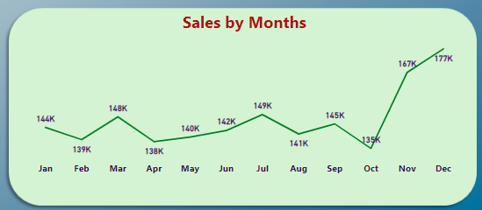
Findings (Sales Overview)
Sales are High in Months Nov. and Dec.
Sales are low in Feb. ,Apr., and Oct.

Slide 8
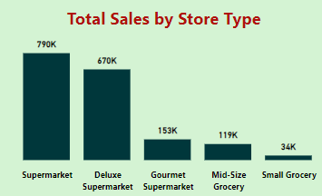
Findings (Sales in Regions)
Sales were high in Supermarkets and Deluxe Supermarket.

Slide 9
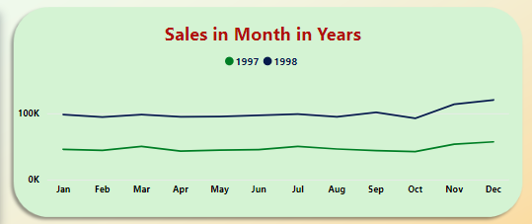
Findings (Sales in Regions)
Sales in 1998 were higher than 1997 , nearly double.
Sales are high in Nov. and Dec.

Slide 10
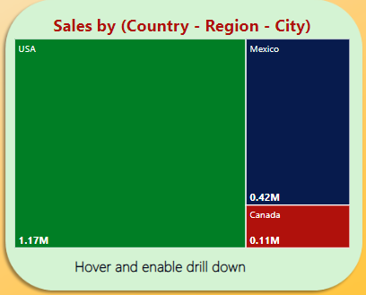
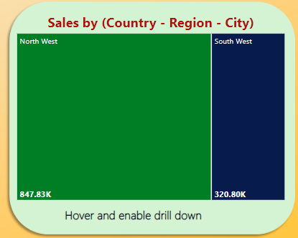
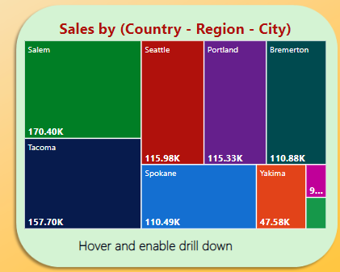
Findings (Sales in Regions)
USA were the best country in sales.
Drill down : in USA best region were North West.
Drill Down : in North west best city were Salem.

Slide 11
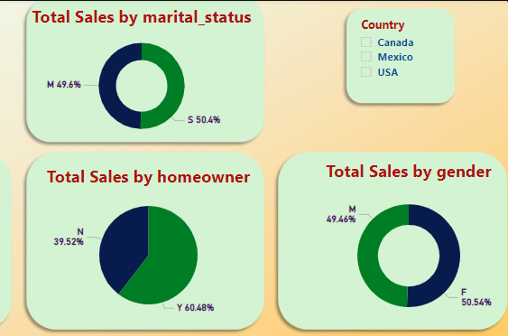
Findings (Demographic Analysis)
In general married or single, male or female in all countries have the same buying behaviors
Home owners are slightly higher in buying than none.

Slide 12
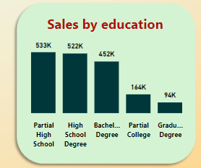
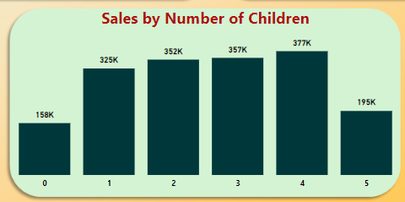
Findings (Demographic Analysis)
High school and partial high school people are the people with high sales.
College and those of graduate degrees have low spellings.
People with no Children or 5 children are low is sales.

Slide 13
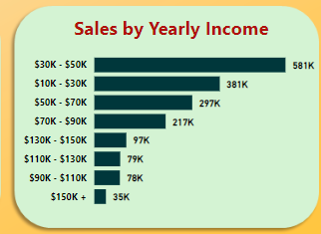
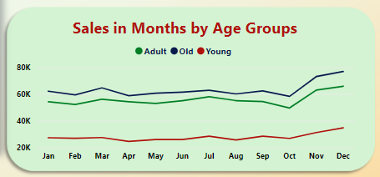
Findings (Demographic Analysis)
People with income from 10-50$ are the ones with high sales.
High income people have less interest in our products
Old age people are the ones interested to buy our products.
Young people do not buy our project mush.

Slide 14


Slide 15
Recommendations
We need more investigation in:
Why people not interested to buy our products in Feb. , April , and Oct.
Why Small Grocery stores have always low spellings.
In USA: why stores Northwest always double selling those in Southwest.
We need to concentrate in our upcoming Marketing Combines on:
Collage Gradate people and Young age people , as they always not interested in buying our products.
We need to take the chance of:
Old people who are interested in our products.
Northwest stores in USA as they are selling well

